Slide 1

C# Fundamentals (cont.)

Slide 2
Learning Objectives
Introduction to Class and Objects in C#
Understand C# Namespace.
Understand Inheritance, polymorphism, encapsulation
Understand and practice with Arrays, Lists, Dictionaries

Slide 3
2.4 Introducing Classes and Objects

Slide 4
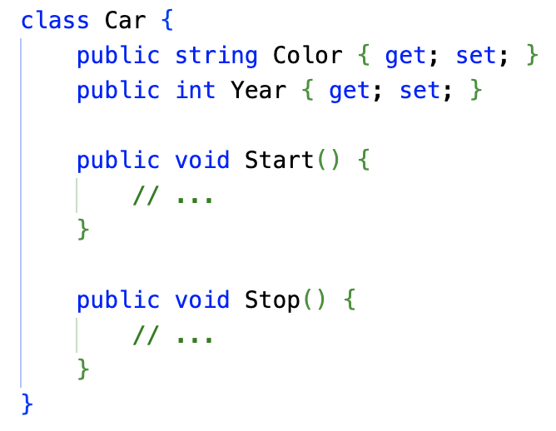
What is a Class?
A blueprint for creating objects.
Defines properties (data) and methods (behavior).
Example

Slide 5
What is a Class?
A blueprint for creating objects.
Defines properties (data) and methods (behavior).
Example

Slide 6
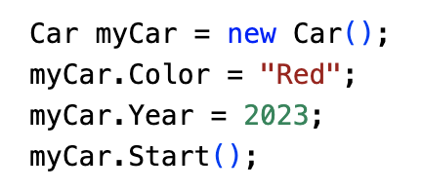
Creating Objects
Use the new keyword to create an instance of a class.
Assign the object to a variable of the class type.
Example:
A class can contain one or more constructors, fields, methods, properties, delegates, and events. They are called class members

Slide 7
Class Members
Fields, Properties, Methods, Constructor
Fields:
Variables that store data within a class.
Can be public, private, protected, or internal.
Properties:
Encapsulate field access and provide controlled access to data.
Can have get and set accessors.
Auto-implemented properties simplify property declaration.

Slide 8
Class Members (cont.)
Fields, Properties, Methods, Constructor
Methods:
Functions that define the behavior of a class.
Can have parameters and return values.
Constructors:
Special methods used to initialize objects.
Can have parameters to provide initial values.

Slide 9
C# Namespace
What are Namespaces?
Namespaces are containers for classes and other namespaces.
They help organize related code and prevent naming conflicts.
The .NET Framework uses namespaces to group its built-in classes (e.g., System, System.Linq, System.Web)

Slide 10
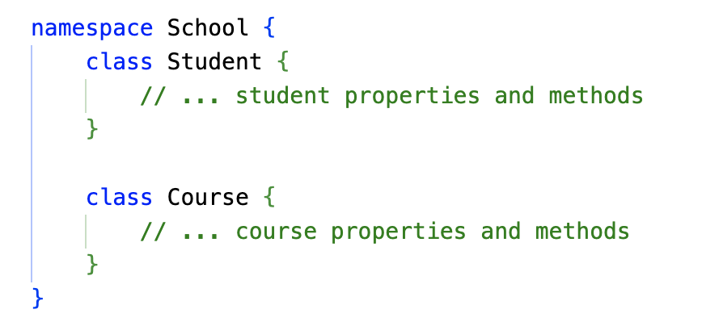
C# Namespace
Defining a Namespace
Use the namespace keyword followed by the desired name.
Classes and other namespaces can be defined within the curly braces.

Slide 11
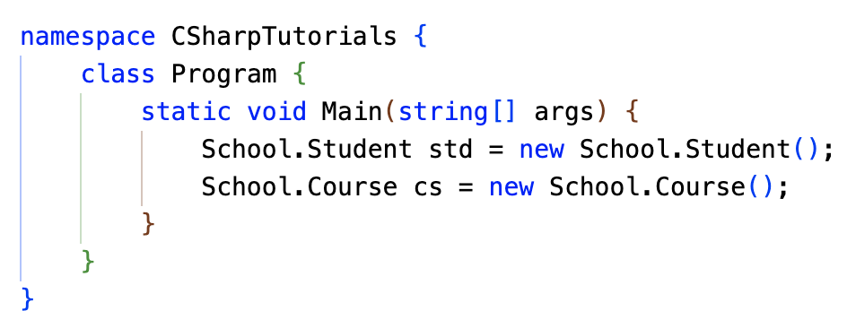
C# Namespace
Accessing Classes within a Namespace
Use namespace.classname syntax to access classes.

Slide 12
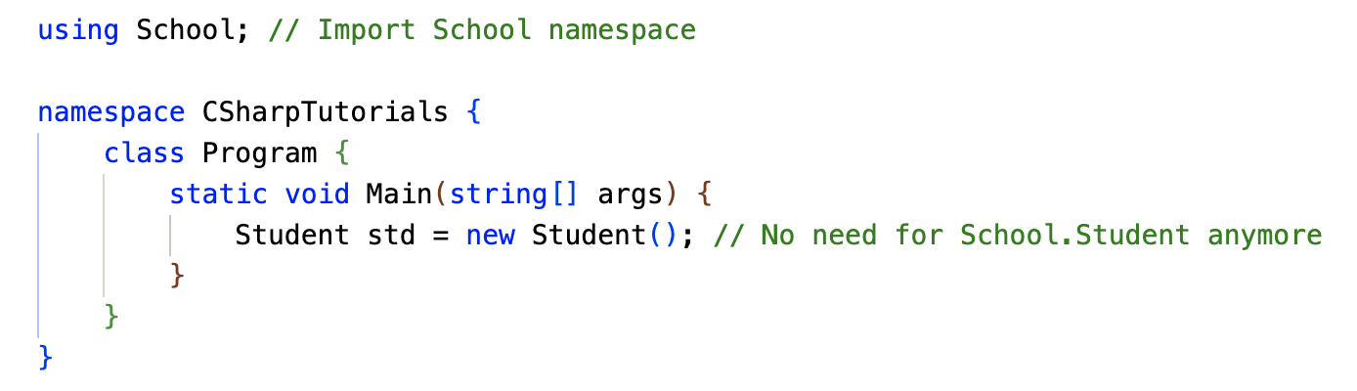
C# Namespace
Using the using Directive
Import an entire namespace to avoid repetitive namespace.classname syntax.
Place using statements at the top of your code file.

Slide 13
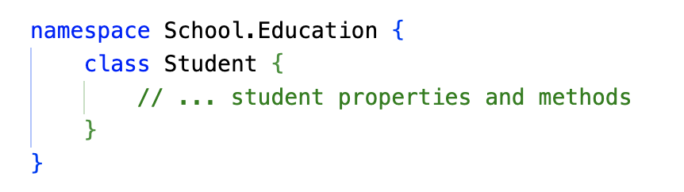
C# Namespace
Nested Namespaces
Namespaces can contain other namespaces for further organization.
Use dots “.” to separate nested namespace levels.
Fully qualified name in this case: School.Education.Student

Slide 14
2.5 Inheritance, polymorphism, encapsulation

Slide 15
Inheritance
What is Inheritance?
A fundamental concept in object-oriented programming.
Allows you to create new classes (derived classes) based on existing classes (base classes).
Promotes code reusability and modularity.
Key Idea: IS-A Relationship
A derived class is a type of its base class.
Example: A Dog is a type of Animal

Slide 16
Inheritance
Base and Derived Classes
Base Class:
Defines common properties and methods.
Serves as a blueprint for derived classes.
Derived Class:
Inherits properties and methods from the base class.
Can add new properties and methods or override existing ones.

Slide 17
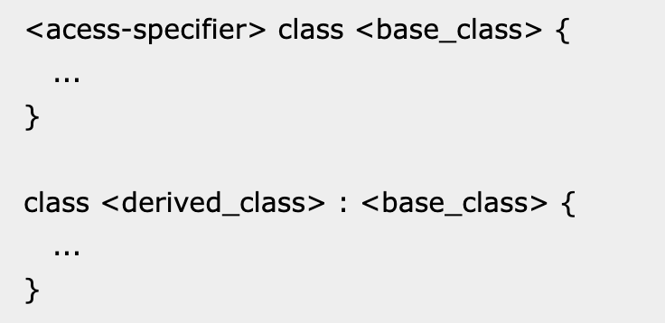
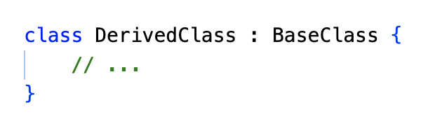
Inheritance
Base and Derived Classes
The syntax used in C# for creating derived classes

Slide 18
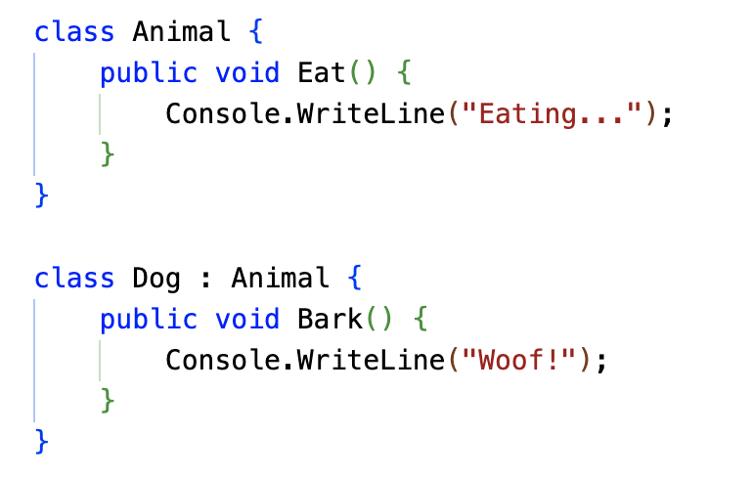
Inheritance
Example

Slide 19
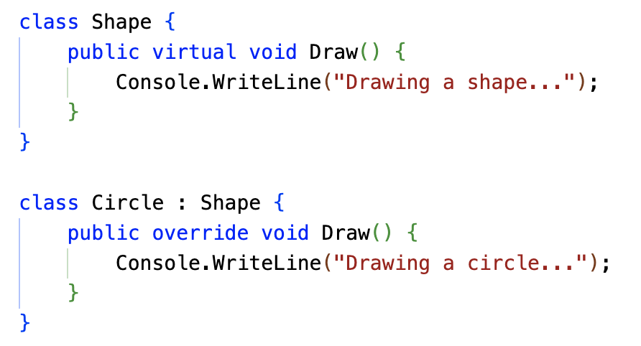
Inheritance
Overriding Methods
A derived class can override a virtual or abstract method of the base class.
The overridden method must have the same signature as the base class method.

Slide 20
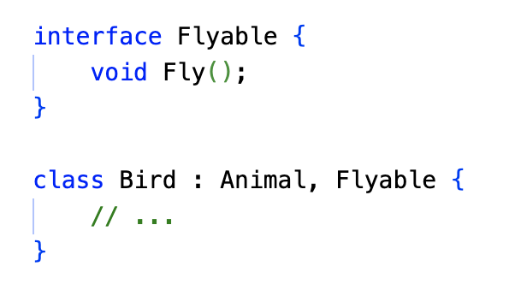
Inheritance
Multiple Inheritance (Interfaces)
C# doesn't support multiple inheritance directly.
Interfaces can be used to achieve multiple inheritance.

Slide 21
Polymorphism
What is Polymorphism?
Polymorphism: One Interface, Multiple Forms
The ability of objects to take on many forms.
It allows you to write more flexible and reusable code.
Two main types:
Compile-time Polymorphism (Static Polymorphism)
Runtime Polymorphism (Dynamic Polymorphism)

Slide 22
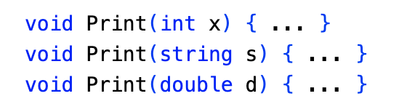
Polymorphism
Static Polymorphism: Function Overloading
Defining multiple functions with the same name but different parameters.
The compiler determines the correct function to call based on the arguments provided.

Slide 23
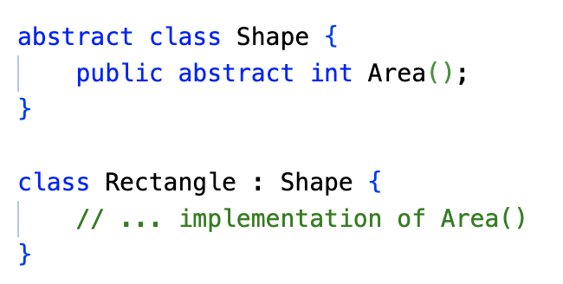
Polymorphism
Dynamic Polymorphism: Overriding and Abstract Classes
Abstract Classes
Classes that cannot be instantiated directly.
Contain abstract methods that must be implemented by derived classes.

Slide 24
Polymorphism
Dynamic Polymorphism: Overriding and Abstract Classes
Key Point:
Dynamic polymorphism allows you to write more flexible and extensible code.
It's often used in conjunction with interfaces to achieve multiple inheritance.

Slide 25
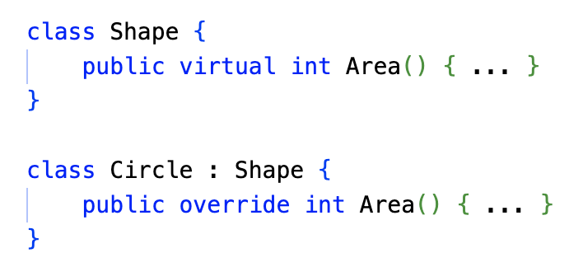
Polymorphism
Dynamic Polymorphism: Overriding and Abstract Classes
Overriding Methods
A derived class can provide a specific implementation for a virtual or abstract method inherited from a base class.

Slide 26
Polymorphism
Benefits of Polymorphism
Code Reusability: By defining a common interface, you can write generic code that works with different object types.
Flexibility: Polymorphism allows you to write more adaptable and maintainable code.
Extensibility: New derived classes can be added without affecting existing code.

Slide 27
Encapsulation
What is Encapsulation?
Encapsulation is the bundling of data (attributes) and methods (functions) that operate on that data within a single unit, the class.
It hides the internal implementation details and provides a public interface to interact with the object.

Slide 28
Encapsulation
Why Encapsulation?
Data Protection: Prevents accidental modification of data.
Code Reusability: Encapsulated classes can be reused in different parts of the application.
Modularity: Encapsulation promotes modular design, making code easier to understand and maintain.

Slide 29
Encapsulation
Access Specifiers
C# provides the following access specifiers:
Public: Accessible from anywhere.
Private: Accessible only within the class.
Protected: Accessible within the class and derived classes.
Internal: Accessible within the same assembly.
Protected Internal: Accessible within the same assembly or derived classes.

Slide 30
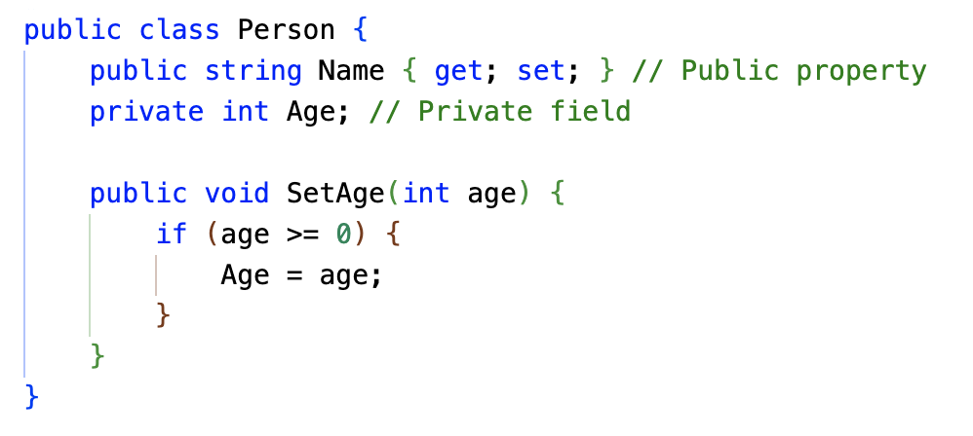
Encapsulation
Example

Slide 31
Encapsulation
Encapsulation and Abstraction
Abstraction: Focuses on the essential features of an object, hiding unnecessary details.
Encapsulation: Implements abstraction by providing a public interface and hiding the internal implementation.

Slide 32
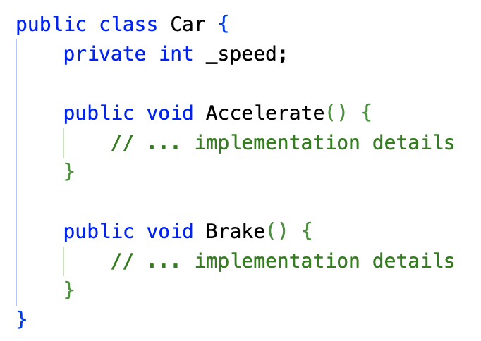
Encapsulation
Encapsulation and Abstraction: Example
In this example, the Car class encapsulates the _speed field and provides public methods Accelerate() and Brake() to interact with it. This hides the internal implementation and provides a controlled interface.

Slide 33
Interface
What is an Interface?
A blueprint for a class.
Defines a contract that classes must adhere to.
Contains only method signatures (no implementation).
Key Points:
Interfaces use the interface keyword.
They cannot contain fields or constructors.
They can contain methods, properties, indexers, and events.

Slide 34
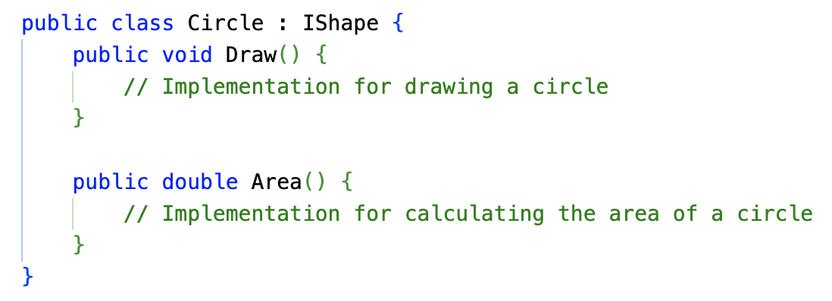
Interface
Implementing an Interface
A class can implement multiple interfaces.
The class must provide implementations for all interface methods.

Slide 35
Interface
Benefits of Using Interfaces
Encapsulation: Hides implementation details.
Polymorphism: Allows objects of different types to be treated as if they were the same type.
Code Reusability: Interfaces promote code reuse and modularity.
Loose Coupling: Reduces dependencies between classes.

Slide 36
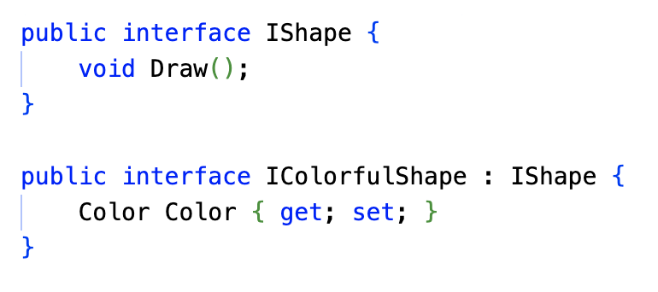
Interface
Interface Inheritance
Interfaces can inherit from other interfaces.
This allows for creating hierarchies of interfaces.
Key Points:
Interfaces are a powerful tool for designing flexible and reusable code.
By using interfaces, you can create well-structured and maintainable applications.

Slide 37
2.6 Array, List, Dictionary

Slide 38
Array
What is an Array?
A collection of elements of the same data type.
Elements are stored in contiguous memory locations.
Accessed using an index, starting from 0.
Declaration and Initialization:

Slide 39
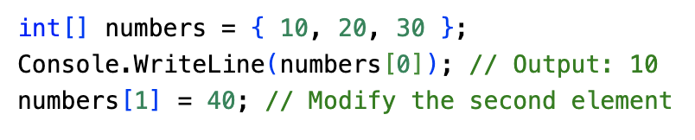
Array
Accessing Array Elements
Use the index to access a specific element.
Index starts from 0.

Slide 40
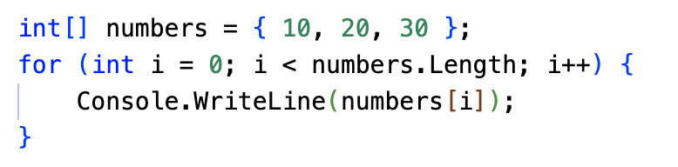
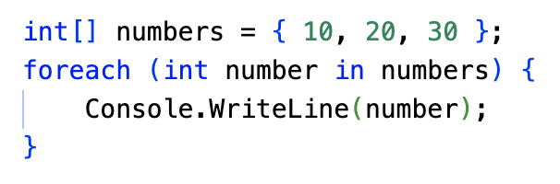
Array
Iterating Through an Array
Using a for loop:
Using a foreach loop:

Slide 41
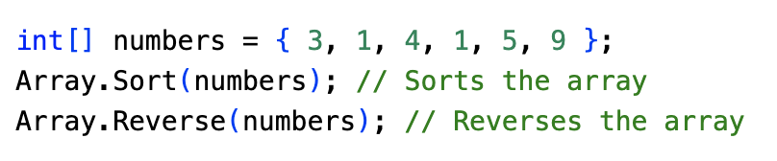
Array
Array Methods
Length: Gets the number of elements in the array.
Sort: Sorts the elements in ascending order.
Reverse: Reverses the order of elements.
IndexOf: Finds the index of a specific element.
Clear: Sets all elements to their default value.

Slide 42
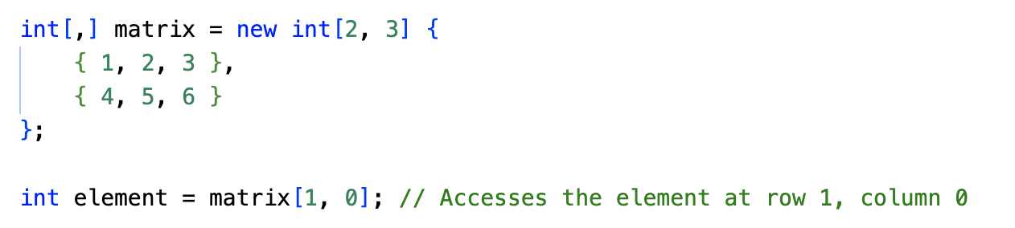
Multidimensional Arrays
Arrays with multiple dimensions.
Declared using multiple pairs of square brackets.

Slide 43
List<T>
What is a List?
A List in C# is a versatile collection that stores a group of strongly typed objects. You can access these objects using their index (position in the list) and manipulate them with various methods. It's like an expandable array that offers advantages like dynamic resizing and built-in functionality for searching, sorting, and modifying elements.

Slide 44
List<T>
What is a List?
Key Points:
Strongly Typed: Ensures type safety and avoids boxing/unboxing operations.
Dynamic Resizing: Grows automatically as you add elements, unlike fixed-size arrays.
Indexes: Elements are accessed by their position (index) starting from 0.
Faster & Safer: Offers better performance and reduces potential errors compared to ArrayList.

Slide 45
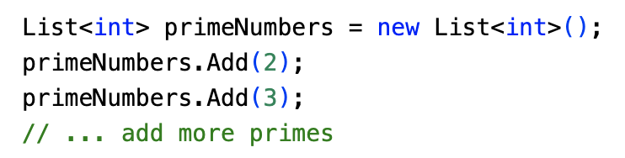
List<T>
Creating a List:
Lists are generic, meaning you specify the type of data they can hold. Here's how to create Lists for different data types:
Integers:

Slide 46
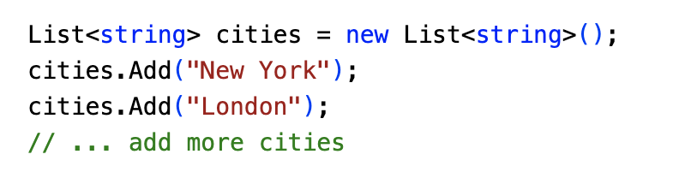
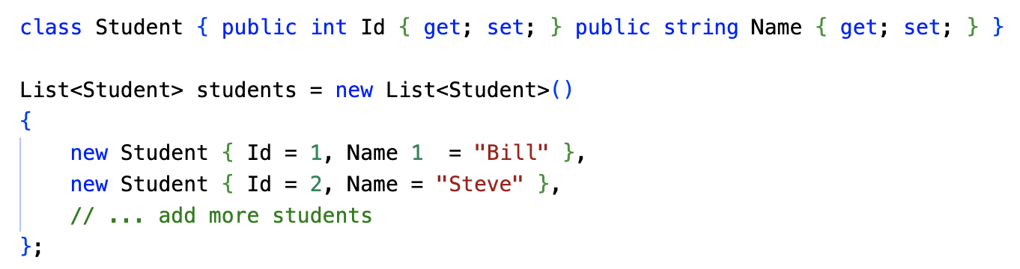
List<T>
Creating a List:
Strings:
Custom Objects:
46

Slide 47
List<T>
Adding Elements:
Add() method: Appends an element to the end of the list.
AddRange() method: Adds all elements from another collection (array or list).
Collection-initializer syntax: Creates a list with initial values during declaration.
Accessing Elements:
By Index: Use square brackets [] with the index (e.g., myList[0]).
Loops: Iterate through the list using foreach or for loops.
LINQ: Leverage LINQ queries for powerful filtering and transformation of list data.

Slide 48
List<T>
Inserting Elements:
Use the Insert(int index, T item) method to insert an element at a specific position within the list.
Removing Elements:
Remove(T item): Removes the first occurrence of a specific element.
RemoveAt(int index): Removes the element at a specified index.
Checking Elements:
The Contains(T item) method helps determine if a particular element exists in the list.

Slide 49
Dictionary<TKey, TValue>
What is a Dictionary?
A Dictionary in C# is a collection of key-value pairs. It's like a real-world dictionary where you look up a word (key) to find its definition (value).
Key Features:
Unique Keys: Each key must be unique within the dictionary.
Efficient Lookup: Keys are used to quickly retrieve values.
Flexible Data Storage: Can store different data types for keys and values.

Slide 50
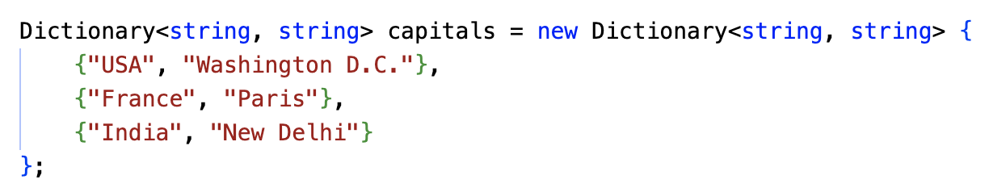
List<T>
Creating a Dictionary:
Accessing Elements:

Slide 51
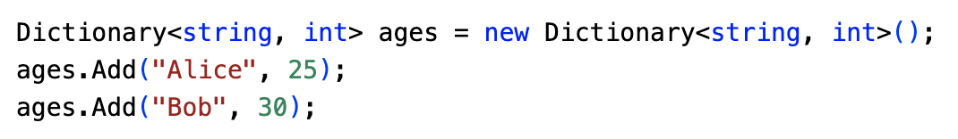
List<T>
Adding Elements:
Use the Add() method to add a new key-value pair.
Use the collection initializer syntax for concise initialization:

Slide 52
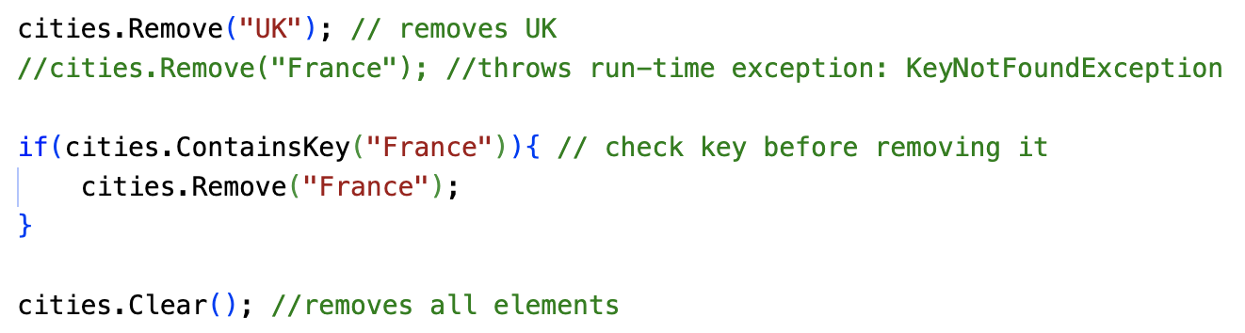
List<T>
Removing Elements:
Use the Remove() method to remove a key-value pair by specifying the key.
Use the Clear() method to remove all elements.

Slide 53
MonoBehaviour
Introduction to MonoBehaviour:
MonoBehaviour is the fundamental class in Unity that forms the backbone of most game objects' behavior. It provides a framework for creating scripts that can be attached to GameObjects within your Unity scene.
Key Features of MonoBehaviour:
Life Cycle Functions
Component-Based Architecture
Event Handling

Slide 54
Key Features of MonoBehaviour
Life Cycle Functions
Awake: Called once when the script instance is being loaded.
Start: Called once before the first frame update.
Update: Called once per frame.
FixedUpdate: Called at a fixed interval, useful for physics calculations.
LateUpdate: Called after all Update functions have finished.
OnDestroy: Called when the GameObject is destroyed.

Slide 55
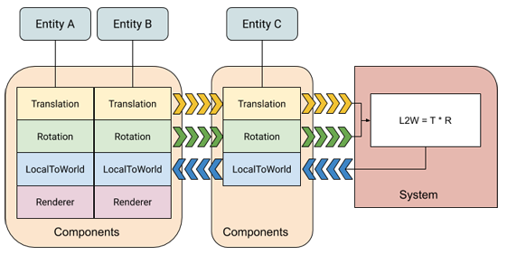
Key Features of MonoBehaviour
Component-Based Architecture
MonoBehaviours are components that can be added to and removed from GameObjects. This allows for flexible and modular game design.
References: https://docs.unity3d.com/Packages/com.unity.entities@0.1/manual/ecs_core.html

Slide 56
Key Features of MonoBehaviour
Event Handling
MonoBehaviours can respond to various events, such as collisions, trigger events, and input events.
Common Event Handling Techniques in Unity:
UnityEvent: A flexible system for creating and invoking events. Can be used to trigger custom events within your scripts. Often used for UI interactions, such as button clicks or slider changes.
Collision and Trigger Events: Used for detecting object collisions and interactions. Such as OnCollisionEnter, OnCollisionExit, OnTriggerEnter, OnTriggerExit...

Slide 57
Key Features of MonoBehaviour
Event Handling
Common Event Handling Techniques in Unity (cont.):
Input Events: Used to respond to player input and control game objects. Such as Input.GetAxis, Input.GetKeyDown, Input.GetKeyUp, Input.GetMouseButtonDown, Input.GetMouseButtonUp …
Custom Events:
Create custom events using C# events or UnityEvents.
Trigger these events from different parts of your game to coordinate actions.

Slide 58
Key Features of MonoBehaviour
Event Handling
Common Event Handling Techniques in Unity (cont.):
Input Events: Used to respond to player input and control game objects. Such as Input.GetAxis, Input.GetKeyDown, Input.GetKeyUp, Input.GetMouseButtonDown, Input.GetMouseButtonUp …
Custom Events:
Create custom events using C# events or UnityEvents.
Trigger these events from different parts of your game to coordinate actions.

Slide 59
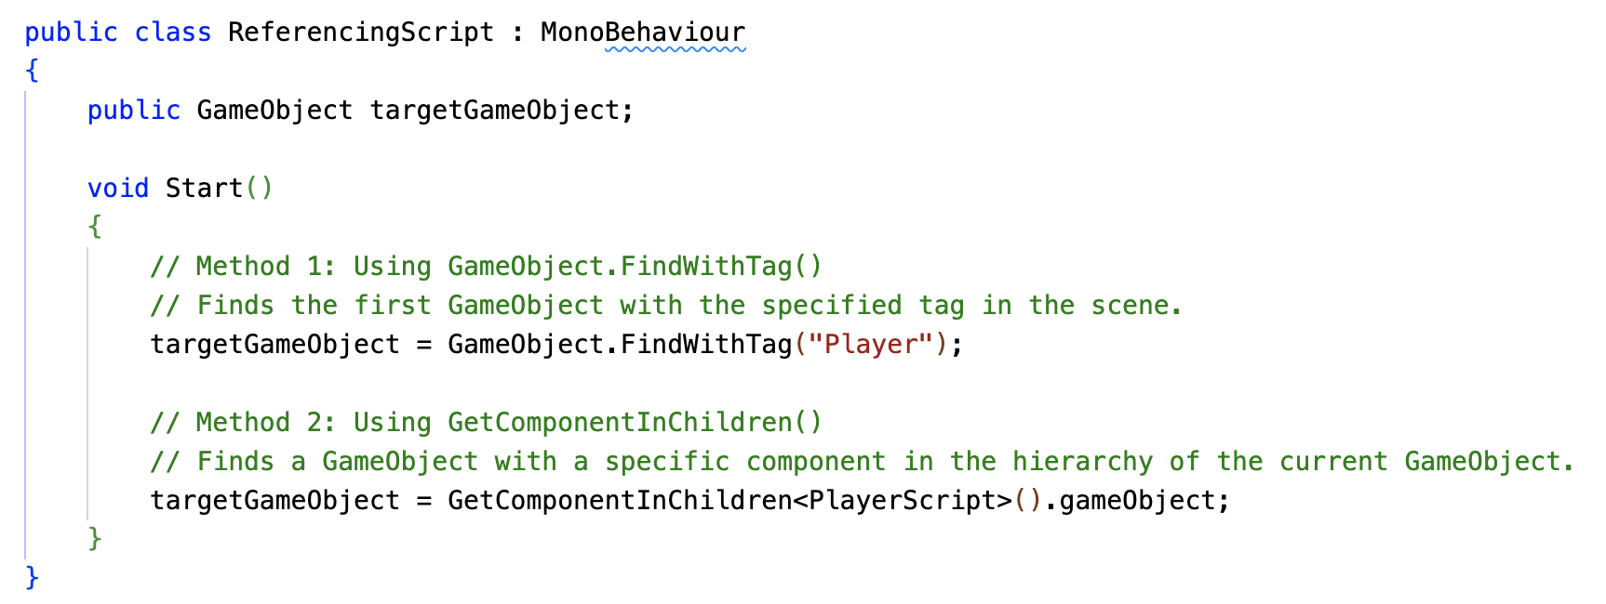
Referencing GameObjects in Unity
What is Referencing?
In Unity, referencing a GameObject allows you to access and manipulate its components from another script. This is crucial for creating interactions between objects in your game.

Slide 60
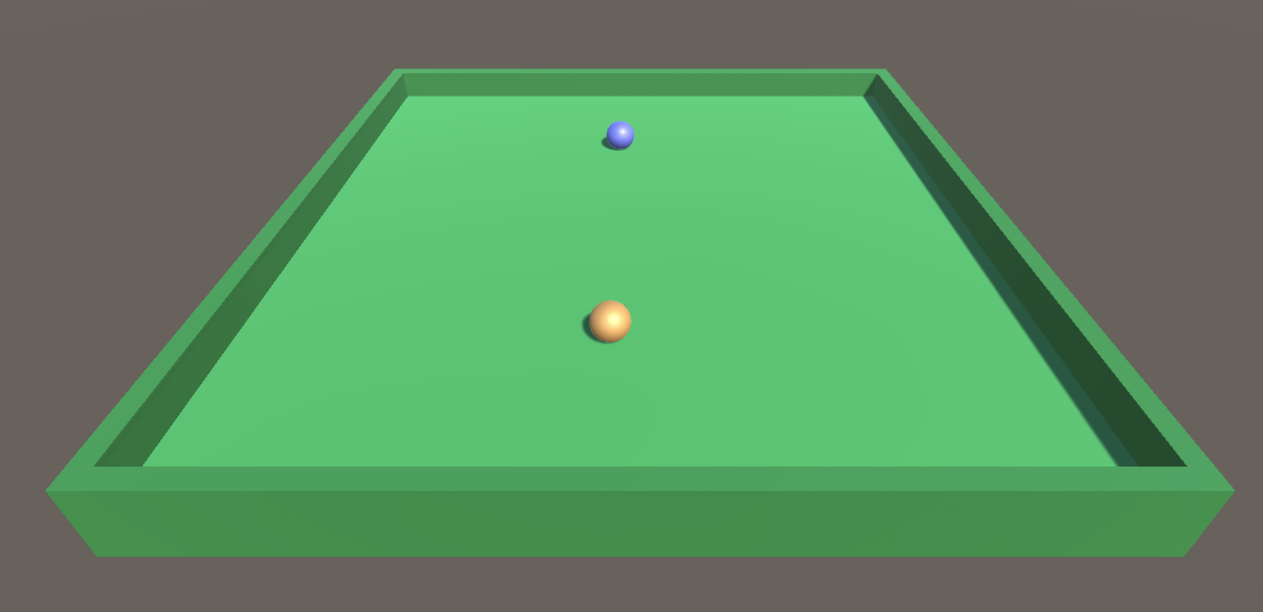
Referencing GameObjects in Unity
Practice with Referencing
Implement a simple color-swapping mechanic.
The player controls an orange ball at the beginning. When colliding with the blue enemy ball, the player ball will change color to the enemy ball, and the enemy ball will randomly change to another color.
Notes:
Ví dụ cụ thể về việc get giá trị của một gameObject khác. Viết game đơn giản trong đó có 2 gameobject chính là player (quả bi màu vàng) với enemy (quả bi màu xanh).
Người chơi điều khiển quả bi Player bằng nút mũi tên.
Khi quả bi player chạm quả bi enemy thì player sẽ bị chuyển sang mau của bi enemy, va enemy sẽ chuyển random sang một màu khác.

Slide 61
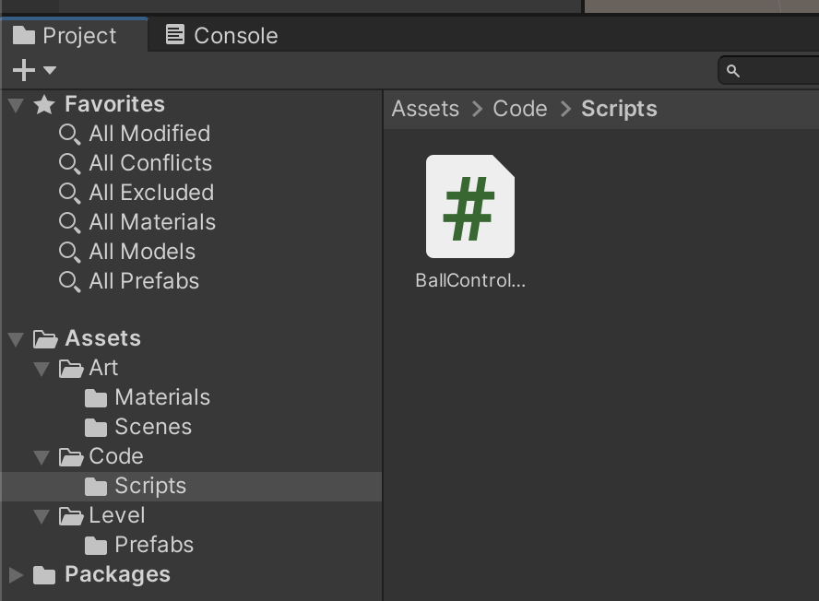
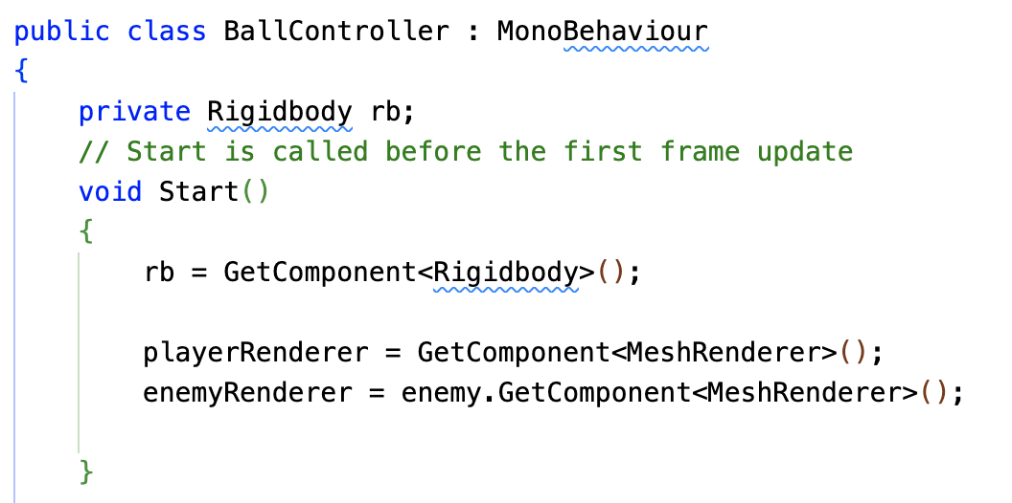
Referencing GameObjects in Unity
Practice with Referencing
Create the C# Script
Create a new C# script:
Name it BallController.
Attach this script to the Player GameObject.
Notes:
Ví dụ cụ thể về việc get giá trị của một gameObject khác. Viết game đơn giản trong đó có 2 gameobject chính là player (quả bi màu vàng) với enemy (quả bi màu xanh).
Người chơi điều khiển quả bi Player bằng nút mũi tên.
Khi quả bi player chạm quả bi enemy thì player sẽ bị chuyển sang mau của bi enemy, va enemy sẽ chuyển random sang một màu khác.

Slide 62
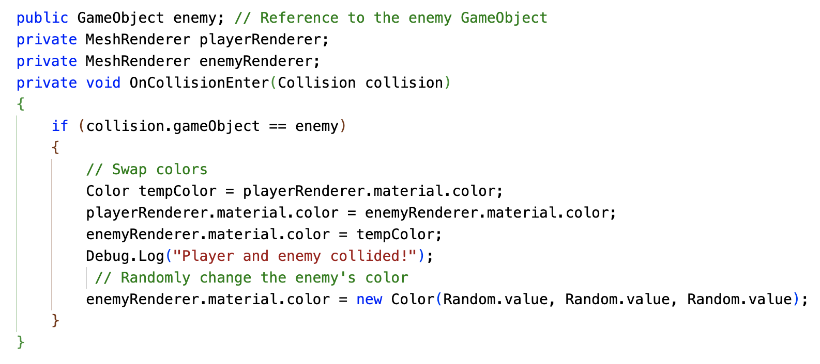
Referencing GameObjects in Unity
Practice with Referencing
Implement Collision Detection and Color Swapping
Notes:
Ví dụ cụ thể về việc get giá trị của một gameObject khác. Viết game đơn giản trong đó có 2 gameobject chính là player (quả bi màu vàng) với enemy (quả bi màu xanh).
Người chơi điều khiển quả bi Player bằng nút mũi tên.
Khi quả bi player chạm quả bi enemy thì player sẽ bị chuyển sang mau của bi enemy, va enemy sẽ chuyển random sang một màu khác.

Slide 63
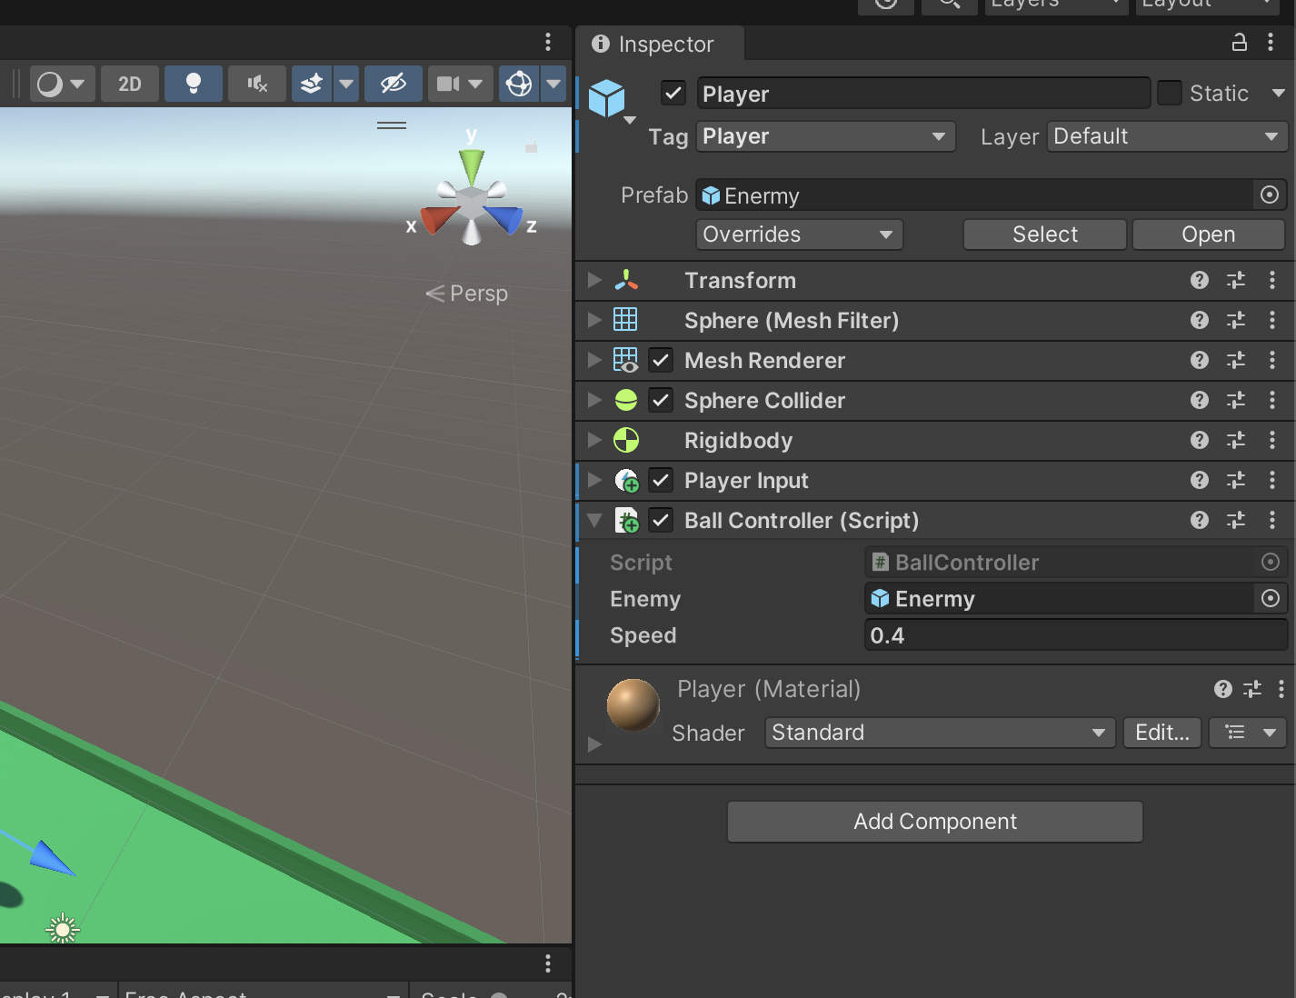
Referencing GameObjects in Unity
Practice with Referencing
Referencing the Enemy GameObject
In the Inspector, drag and drop the Enemy GameObject onto the enemy field in the ColorSwapper script.
Notes:
Ví dụ cụ thể về việc get giá trị của một gameObject khác. Viết game đơn giản trong đó có 2 gameobject chính là player (quả bi màu vàng) với enemy (quả bi màu xanh).
Người chơi điều khiển quả bi Player bằng nút mũi tên.
Khi quả bi player chạm quả bi enemy thì player sẽ bị chuyển sang mau của bi enemy, va enemy sẽ chuyển random sang một màu khác.

Slide 64
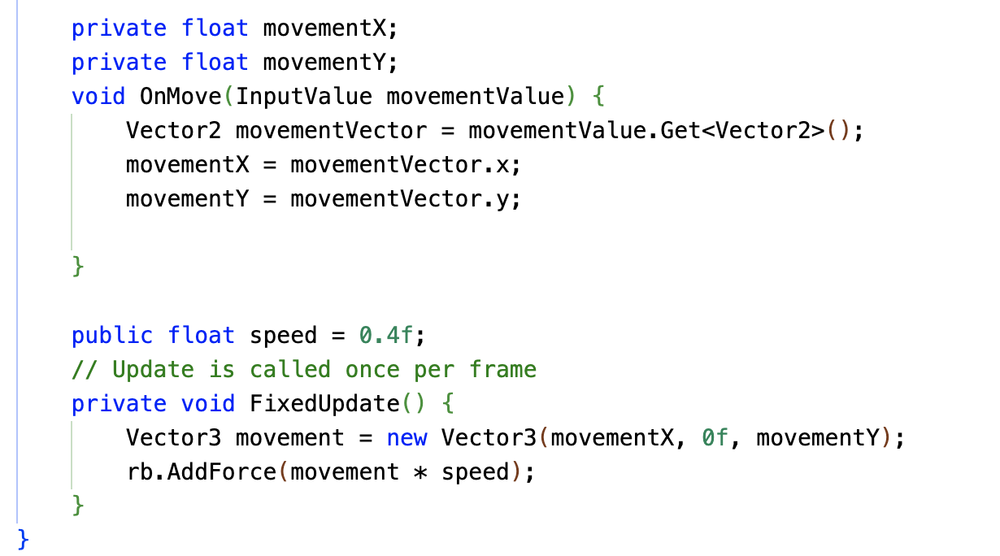
Referencing GameObjects in Unity
Practice with Referencing
Control the player
Notes:
Ví dụ cụ thể về việc get giá trị của một gameObject khác. Viết game đơn giản trong đó có 2 gameobject chính là player (quả bi màu vàng) với enemy (quả bi màu xanh).
Người chơi điều khiển quả bi Player bằng nút mũi tên.
Khi quả bi player chạm quả bi enemy thì player sẽ bị chuyển sang mau của bi enemy, va enemy sẽ chuyển random sang một màu khác.

Slide 65
Recap
Core Concepts:
Classes and Objects: The fundamental building blocks of object-oriented programming in C#.
Inheritance: Creating new classes (derived) based on existing ones (base) to promote code reusability.
Polymorphism: The ability of objects to take on many forms, enabling flexible and adaptable code.
Encapsulation: Protecting data and methods within a class, controlling access and promoting modularity.
Interfaces: Defining contracts that classes must adhere to, promoting loose coupling and code reusability.

Slide 66
Recap
Data Structures:
Arrays: Ordered collections of elements of the same data type.
Lists: Dynamically sized collections, offering flexibility and efficient operations.
Dictionaries: Key-value pairs for efficient data retrieval and storage.
Key Takeaways:
Object-Oriented Programming (OOP) Principles: Understanding OOP principles like inheritance, polymorphism, and encapsulation is crucial for writing well-structured and maintainable C# code.
Data Structures: Choosing the right data structure (array, list, dictionary) is essential for efficient data manipulation and storage.
LINQ: A powerful tool for querying and manipulating data in a concise and expressive way.
C# Syntax and Features: Mastering C# syntax, including keywords, operators, control flow statements, and language constructs, is essential for effective programming.

